Slide 1



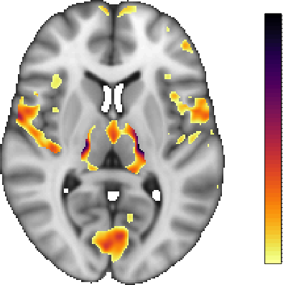
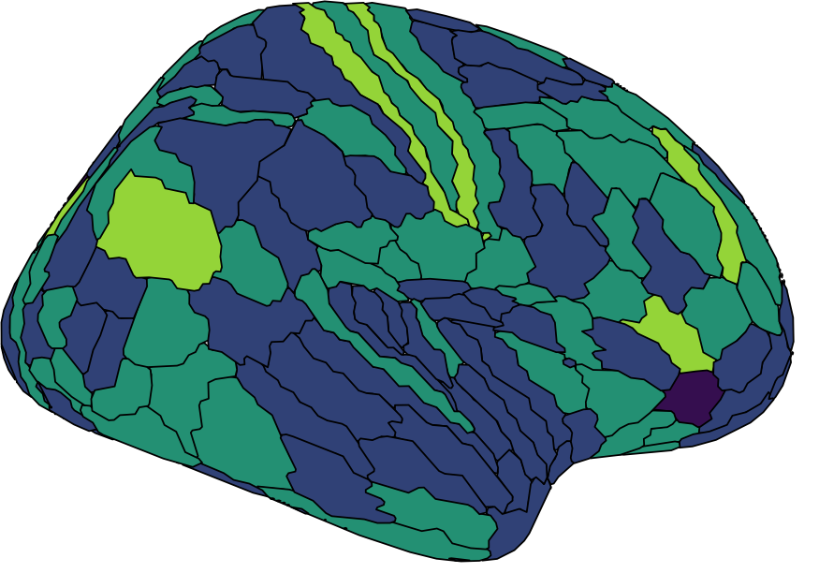
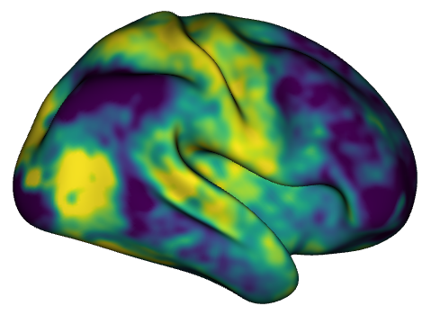
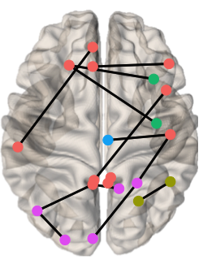
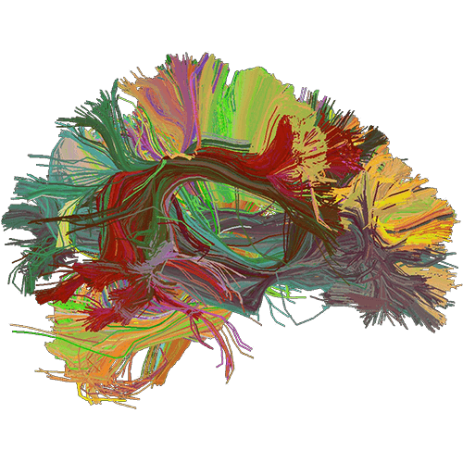

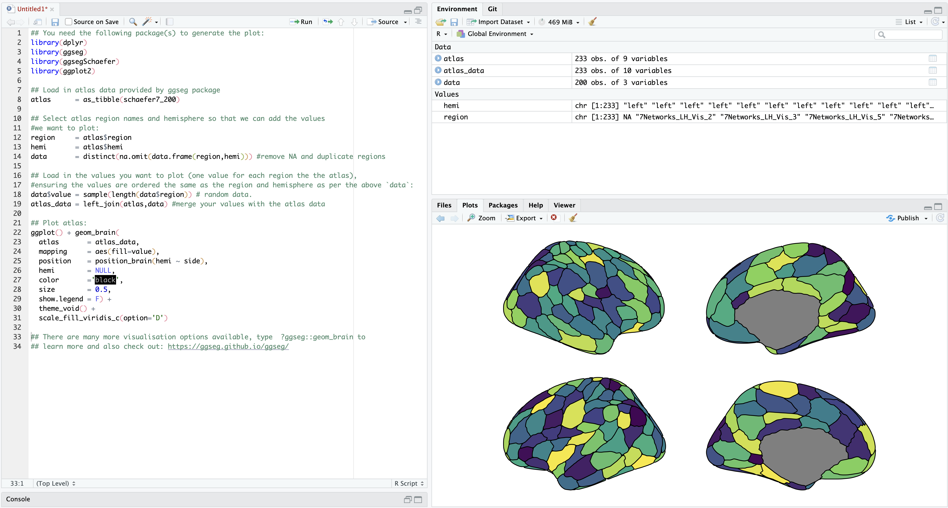




1
Select your programming language
Identify your type of visualization
2
Voxel Region Vertex Edge Streamline
4
Select a package/library
3
Identify your data and file-type
Vector
(e.g. .txt, .csv)
MRI-specific file type examples
Package | Library | Toolbox
ggseg | surfplot | Brainspace
brainconn | nilearn | FieldTrip
fsbrain | pySurfer | Lead-DBS
ciftitools | DIPY | Brainstorm
… | … | …
Region | Value
ROI 1 | 4.1
ROI 2 | 3.8
… | …
ROI X | 1.4
File-type | content
NIFTI (.nil) | Voxel
CIFTI (.cii) | Vertex and/or Voxel
GIFTI (.gii) | Vertex
FreeSurfer (e.g. .mgz) | Vertex, Voxel, Labels
Tractography (e.g. .tck, .trk) | Streamlines
Matrix
(e.g. .txt, .csv)
ROI 1
1 | 6 | 2 | 3
8 | 1 | 5 | 6
9 | 3 | 1 | 1
0 | 4 | 5 | 1
ROI 2
See Table 1 for full list!
ROI 3
ROI x
ROI 1
ROI 3
ROI 2
ROI x
5
Generate visualization
6
Share visualization and code
See Section 4 for template generator!
Notes:
Add a tab in the shiny app – list table
Develop a package selecter
More advacnes users may work backwards, And first I dentify a

Slide 2
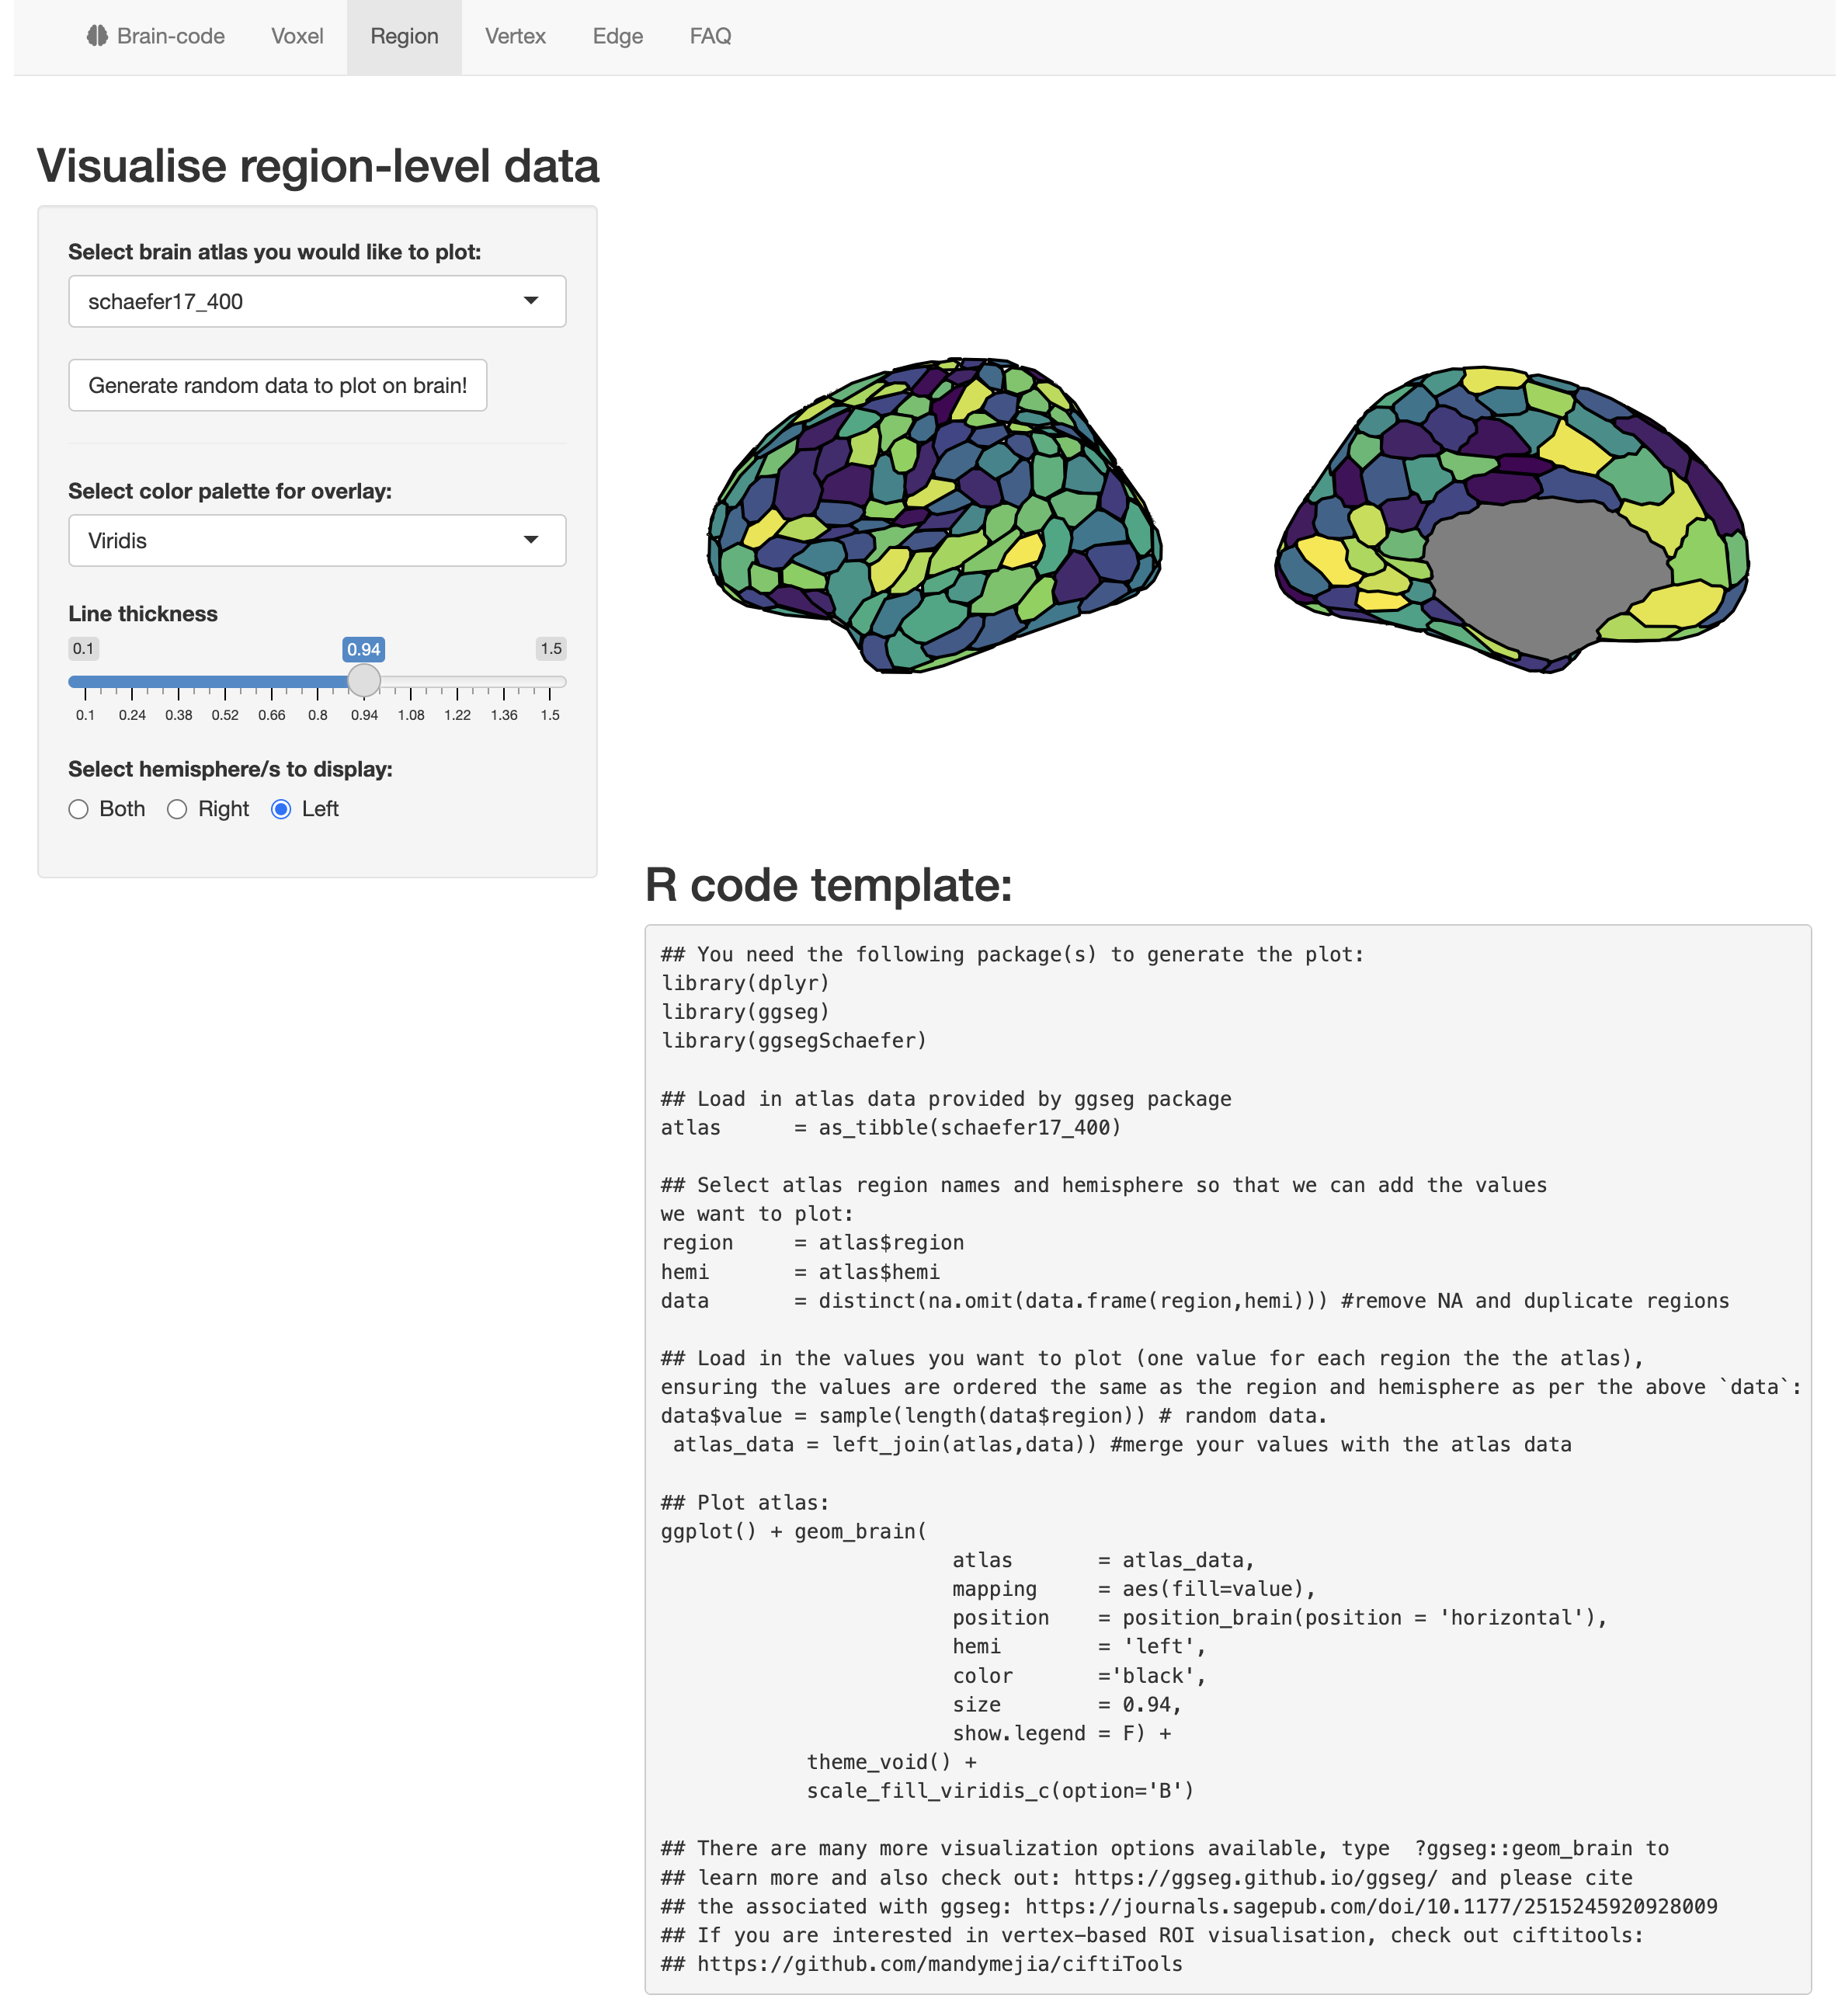
1
2
4
3
5

